Slide 1



Optimizing EU Transmission Grid

Slide 2
Background Information
&
Motivation
Juan Baek

Slide 3
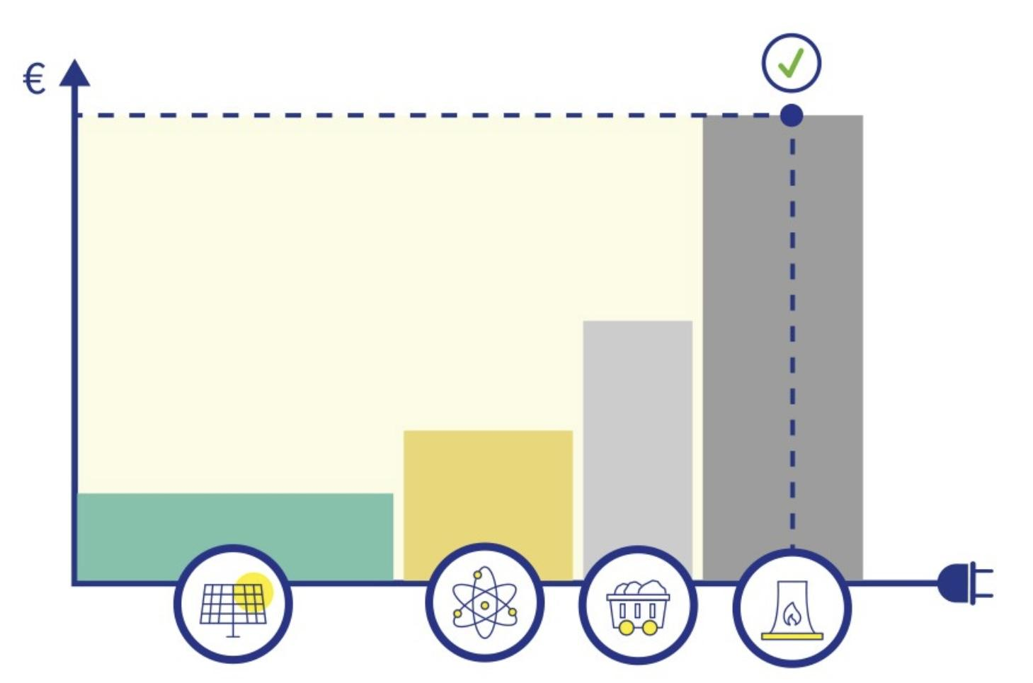
Background Information
Electricity is traded like a commodity where the cheapest electricity gets sold first. Usually this is electricity from renewable energy.
If supply is not sufficient, other, more expensive power plants can sell their electricity (coal and gas).
However, the electricity is not sold at the individual price offered by each power plant. The price will settle at the price offered by the last and most expensive power plant.¹
10 May 2023. Infographic - How Is EU Electricity Produced and Sold?, Consilium Europa, https://www.consilium.europa.eu/en/infographics/how-is-eu-electricity-produced-and-sold/.

Slide 4
Cost of Electricity
Most Expensive
Other
Oil
Most Expensive Energy Sources are often from fossil fuels.
Natural Gas
Coal
Renewable energy sources are produced at zero cost and are therefore by definition always the cheapest
Nuclear
Renewable
Least Expensive

Slide 5
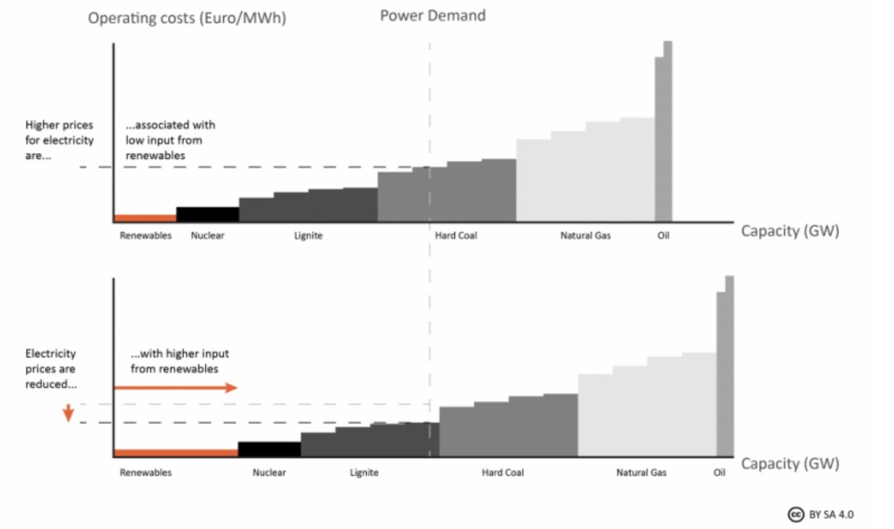
The Merit Order Effect
Illustrating Electric Price Fluctuations Due to The Merit Order Effect. Setting the Power Price: The Merit Order Effect, Clean Energy Wire, https://www.cleanenergywire.org/factsheets/setting-power-price-merit-order-effect.

Slide 6
Motivation
European energy market is one of the world’s most integrated markets with renewable energy.
European market is now classified as a wholesale market according to the European Commision.
New system of marginal pricing known as pay-as-clear market
Assuming all countries in the project follow EU market system
Want to see what transmission grid looks like using day ahead prices.

Slide 7
Exploring 3 different scenarios
Scenario 3:
We set a goal of electricity production and CO2 emissions, for example, 100 grams of CO2 per kWh and see what percentage of renewable energy has to be integrated into the grid by each country.
03
Scenario 1:
Optimize consumer cost (day ahead prices) with no limit to transmission capacity
01
02
Scenario 2:
Optimize using the transmission capacity data given by the EU.

Slide 8
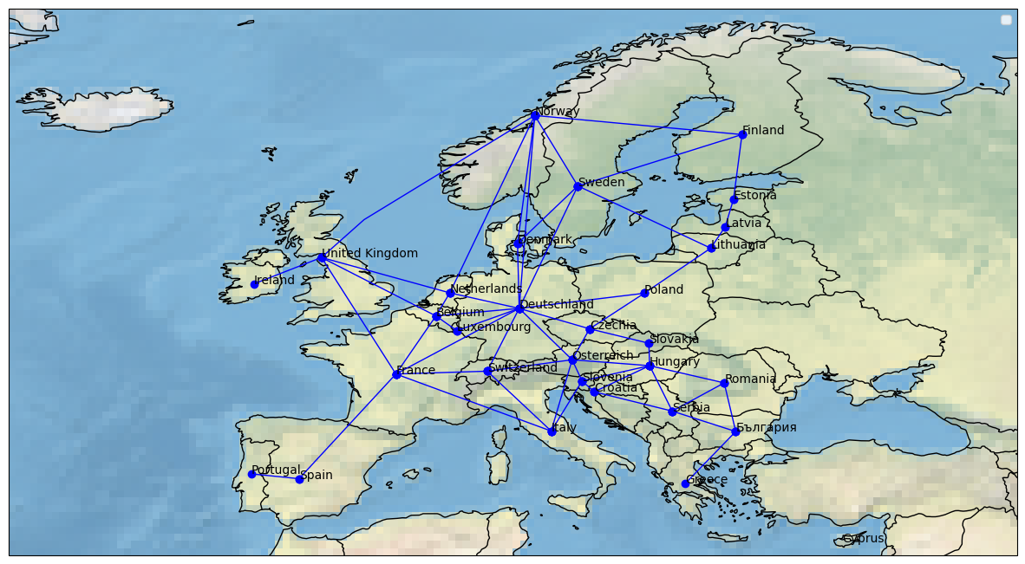
Transmission Lines

Slide 9
Data Acquisition
Matthieu Dominici

Slide 10
Optimization Range
Spring Equinox
March 21st
Fall Equinox
September 21st
JAN
FEB
MAR
APR
MAY
JUN
JUL
AUG
SEP
OCT
NOV
DEC
Summer Solstice
June 21st
Winter Solstice
December 21st
Notes:
We chose to optimize for 4 different days: March, June, September and December 21st, as they represent different interesting generation and load profiles. December: high demand due to electric heating, but low solar and wind power. And summer, high solar but lower demand due to low AC integration in Europe.

Slide 11
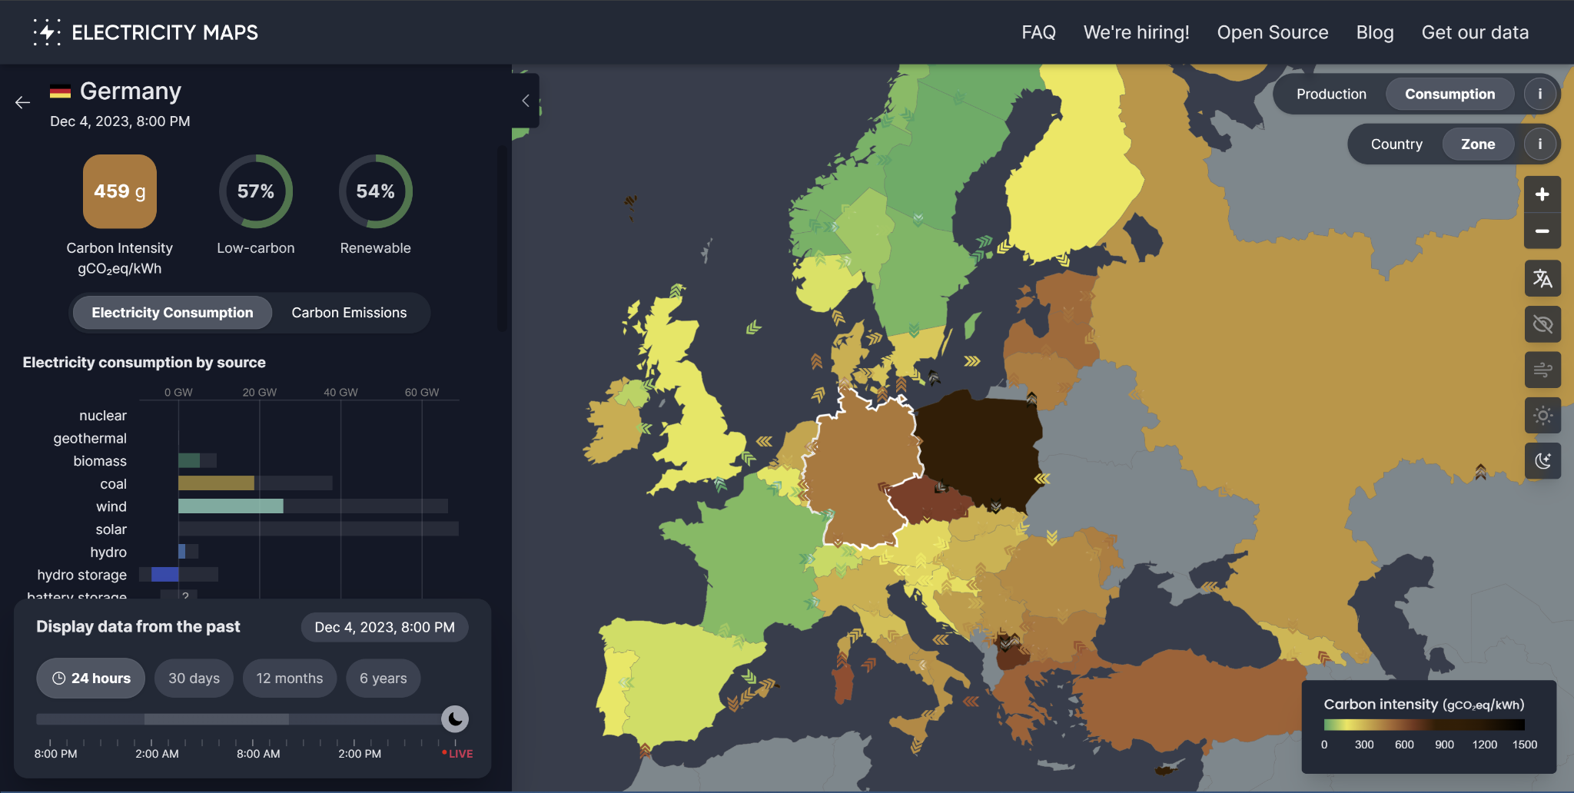
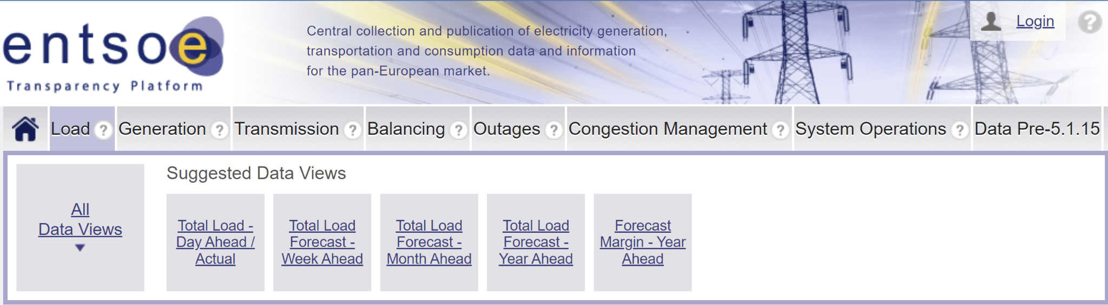
Possible Data Sources
Electricity Maps
ENTSO-E Transparency Platform
Notes:
Now, we need to collect the data, because we are starting from nothing, First possibility was using Electricity Maps, a company that aggregates electricity data from multiple sources, but the free trial of their API does not give access to all the data we need. So we went with ENTSO-E Transparency Platform. ENTSO-E is the European Network of Transmissions System Operators for electricity, and they aggregates data from 39 TSOs in 35 European countries. And access to their API is free.

Slide 12
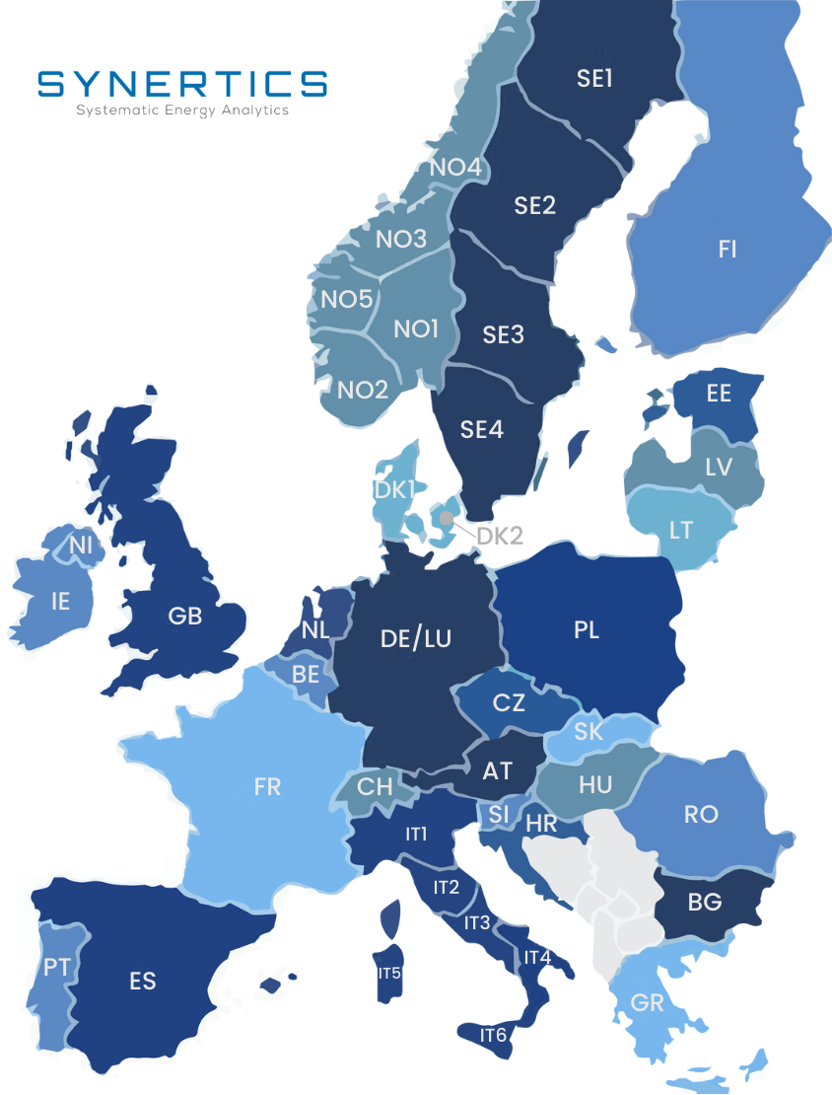
Necessary vs. Available Data
Type of data:
Load - Generation Capacity
Generation Costs - Day-ahead price
Transmission capacities - Cross-border Flows
Hourly data → 4 x 24 = 96 Algo Runs
Choices of nodes: bidding zone, control area, country ?
Notes:
Now, what data do we need ?
Load and Generation data obviously, and we have access to this thanks to ENTSO-e.
However, we don’t have generation costs because it is private industrial data. So we went with the day-ahead prices for each country, but it makes sense as it is a pay to clear market with marginal pricing.
Now, we need transmission capacities. It’s hard to find aggregated data for this on the scale of Europe, so what we do is for each pair of country, get the maximum cross border flow of electricity in the span of 5 years and set this as our maximum transmission capacity.
All this data is hourly data. This gives us 24 data sets per day, and a total of 96 algo runs for 4 days.
Regarding the choice of nodes, the natural choice for us was to go one transmission node = 1 country. However, some countries like Norway, Sweden and Italy have multiple nodes each with its own day ahead prices within them, so we decided to aggregate the data for each country to end up with 1 country = 1 node.
And this is for data acquisition. Now Jay for some preliminary results.

Slide 13
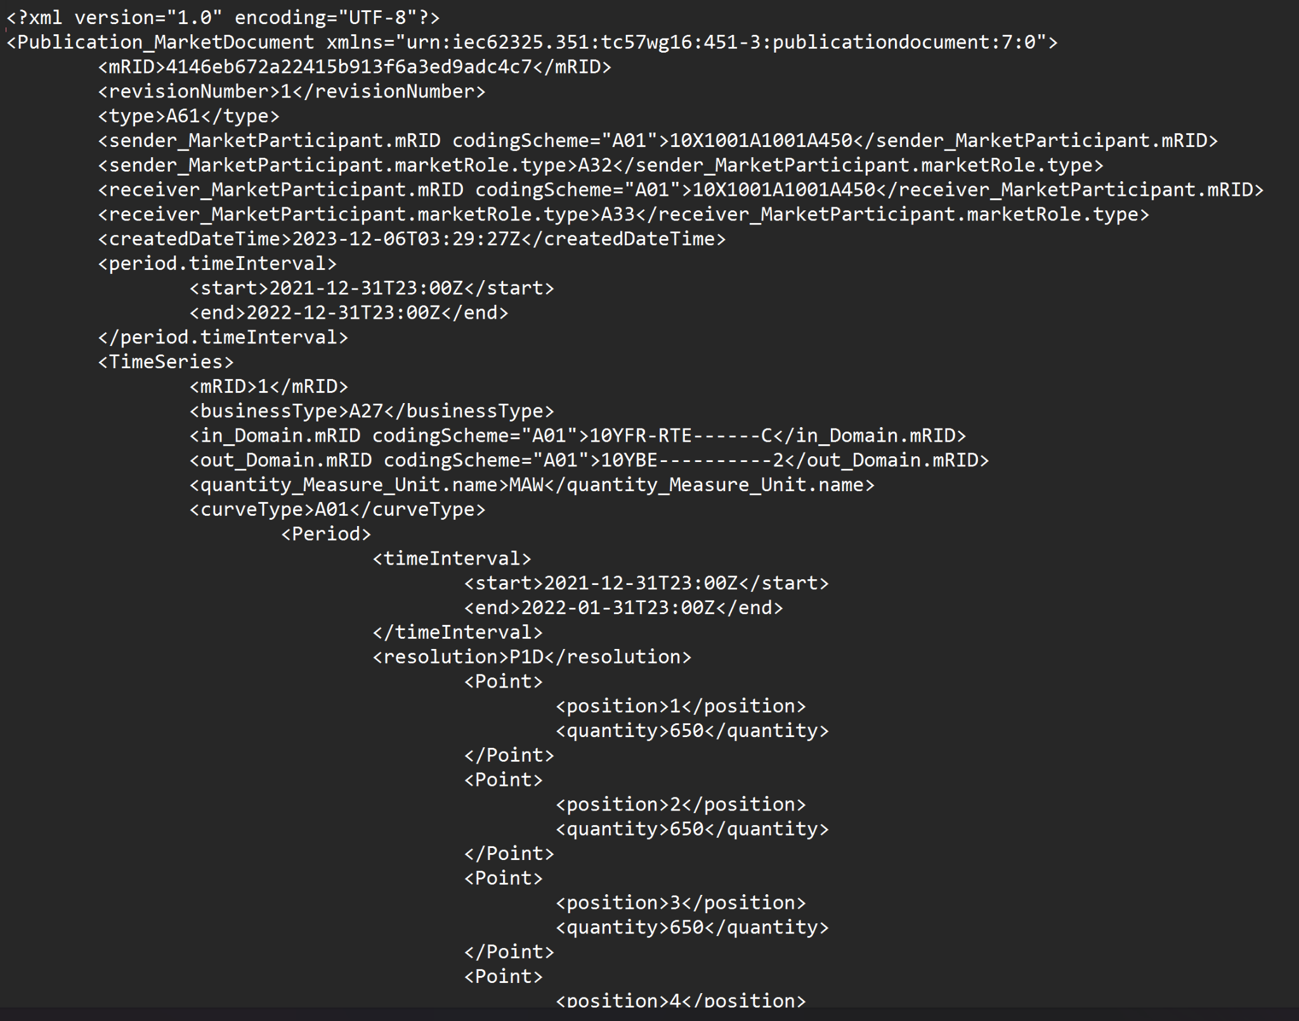
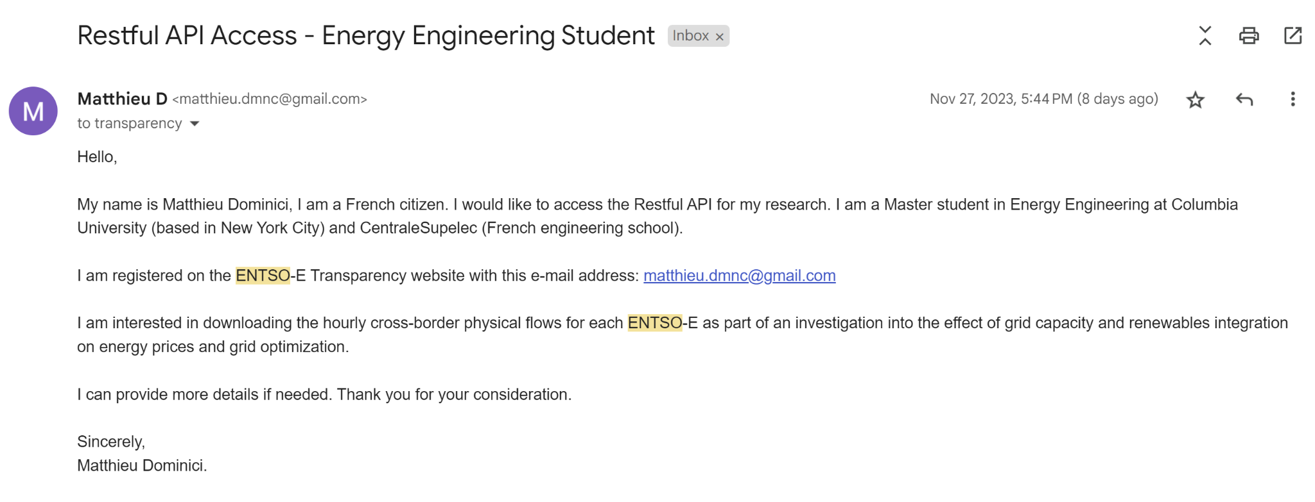
Access ENTSO-E Transparency Data

Slide 14
Optimization Range
1 day 1 month 1 year Select Days
Blue is the colour of the clear sky and the deep sea
Red is the colour of danger and courage
Black is the color of ebony and of outer space
Yellow is the color of gold, butter and ripe lemons
White is the color of milk and fresh snow
Blue is the colour of the clear sky and the deep sea
JAN
FEB
MAR
APR
MAY
JUN
JUL
AUG
SEP
OCT
NOV
DEC
Yellow is the color of gold, butter and ripe lemons
White is the color of milk and fresh snow
June 21
Red is the colour of danger and courage
Black is the color of ebony and of outer space
Yellow is the color of gold, butter and ripe lemons

Slide 15
Methodology
&
Results
Jiarong Xie

Slide 16
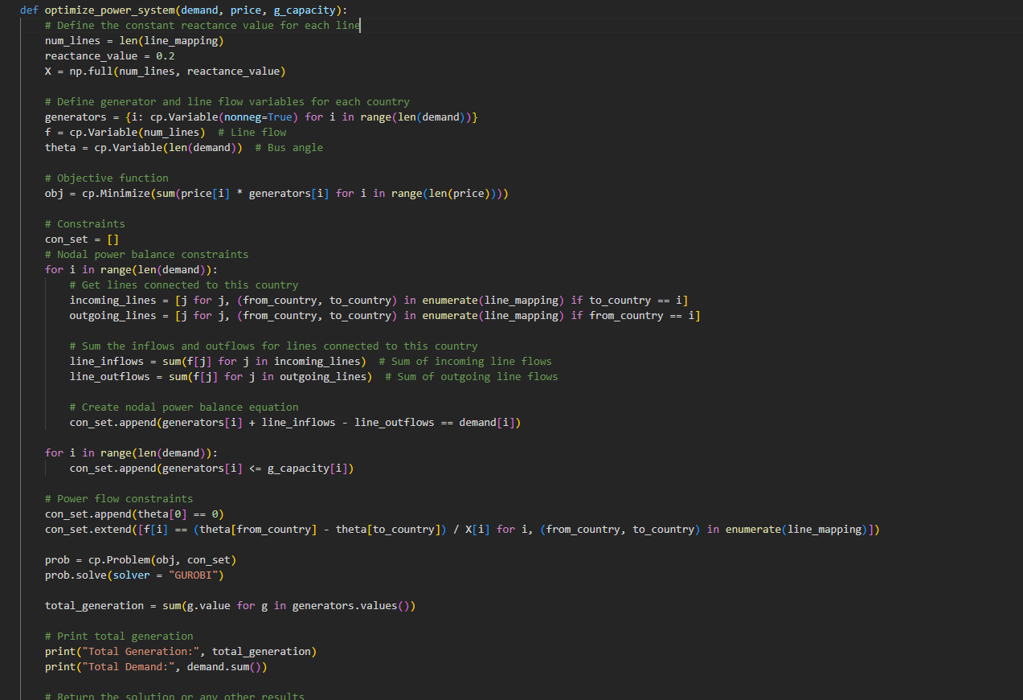
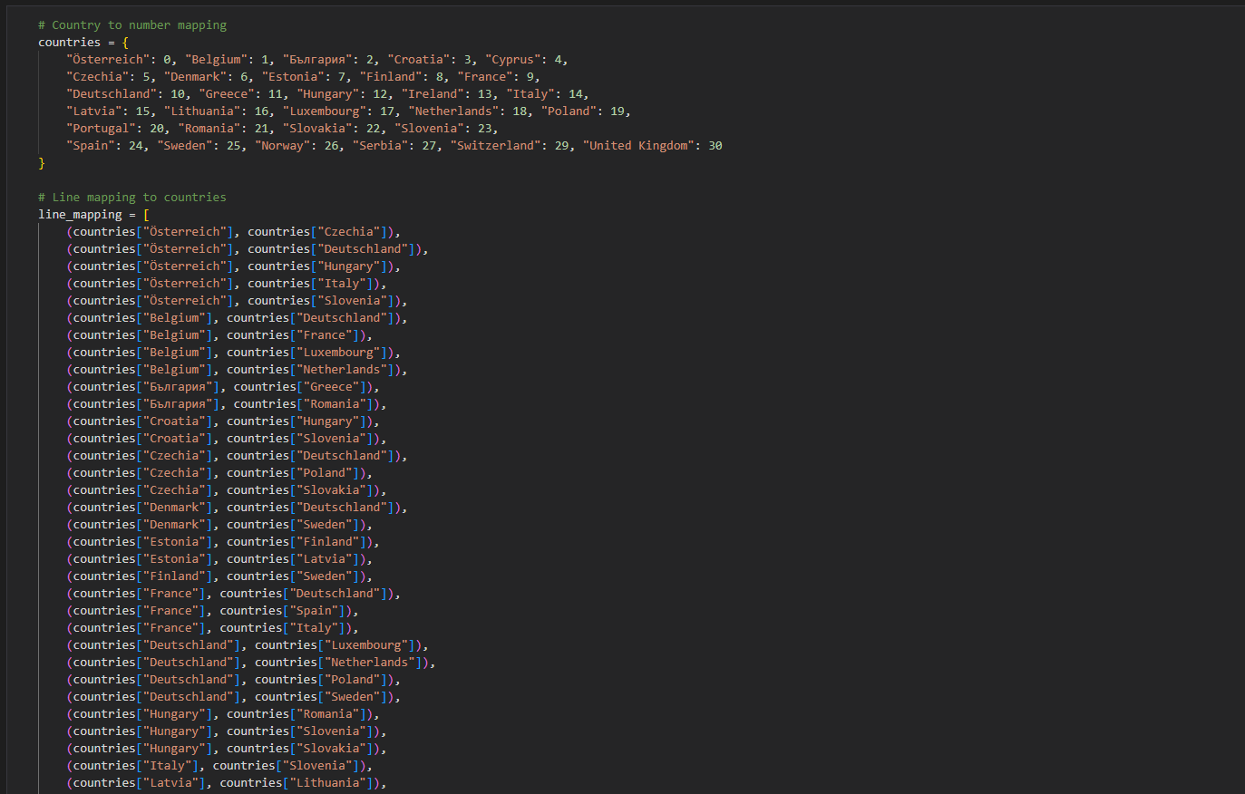
Method
Objective: - Minimize generator costs (Scenario 1, 2)
- Minimize CO₂ emissions to meet goals (Scenario 3)
Input data: Hourly Demand Day-ahead
Constraints: Generation Capacities Transmission Capacities

Slide 17
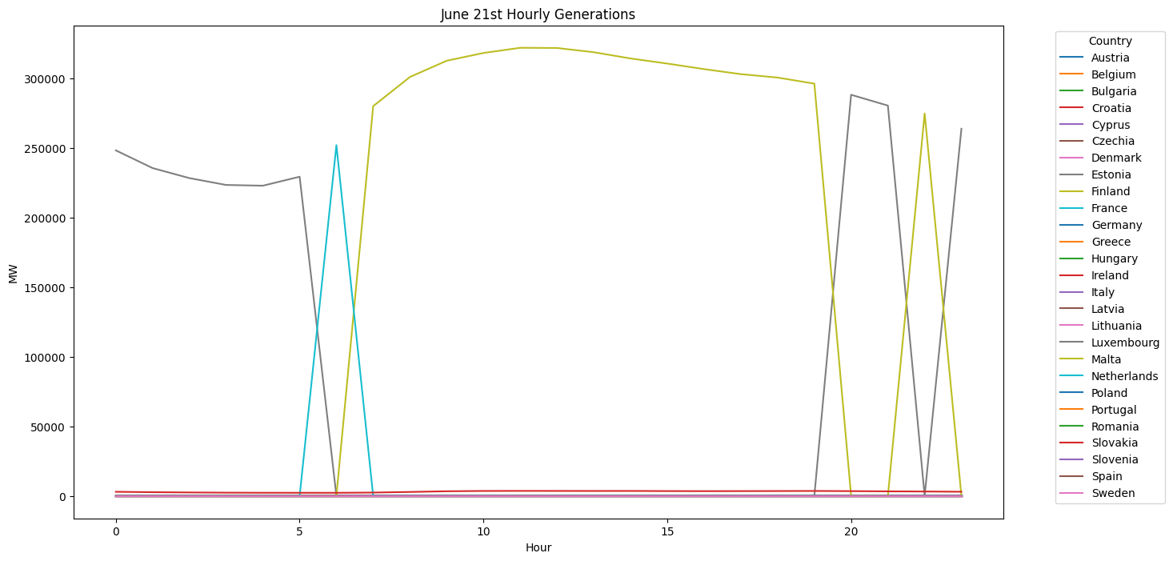
Result

Slide 18
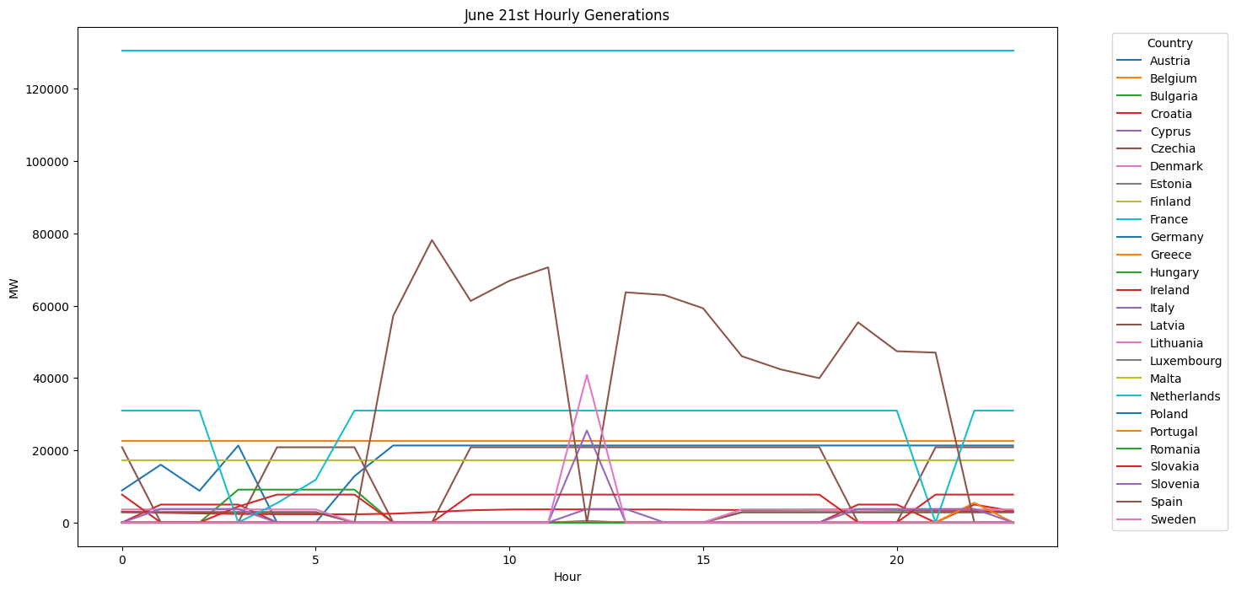
Result

Slide 19
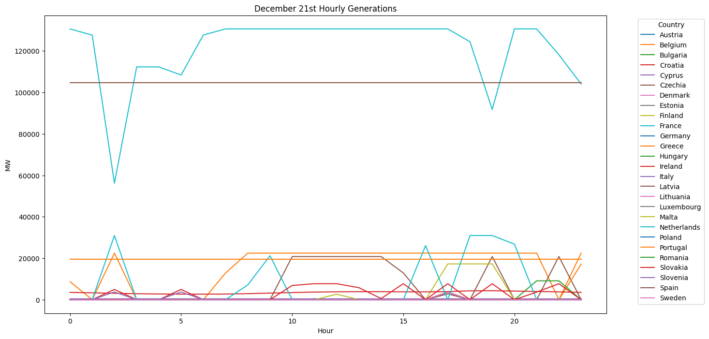
Result

Slide 20
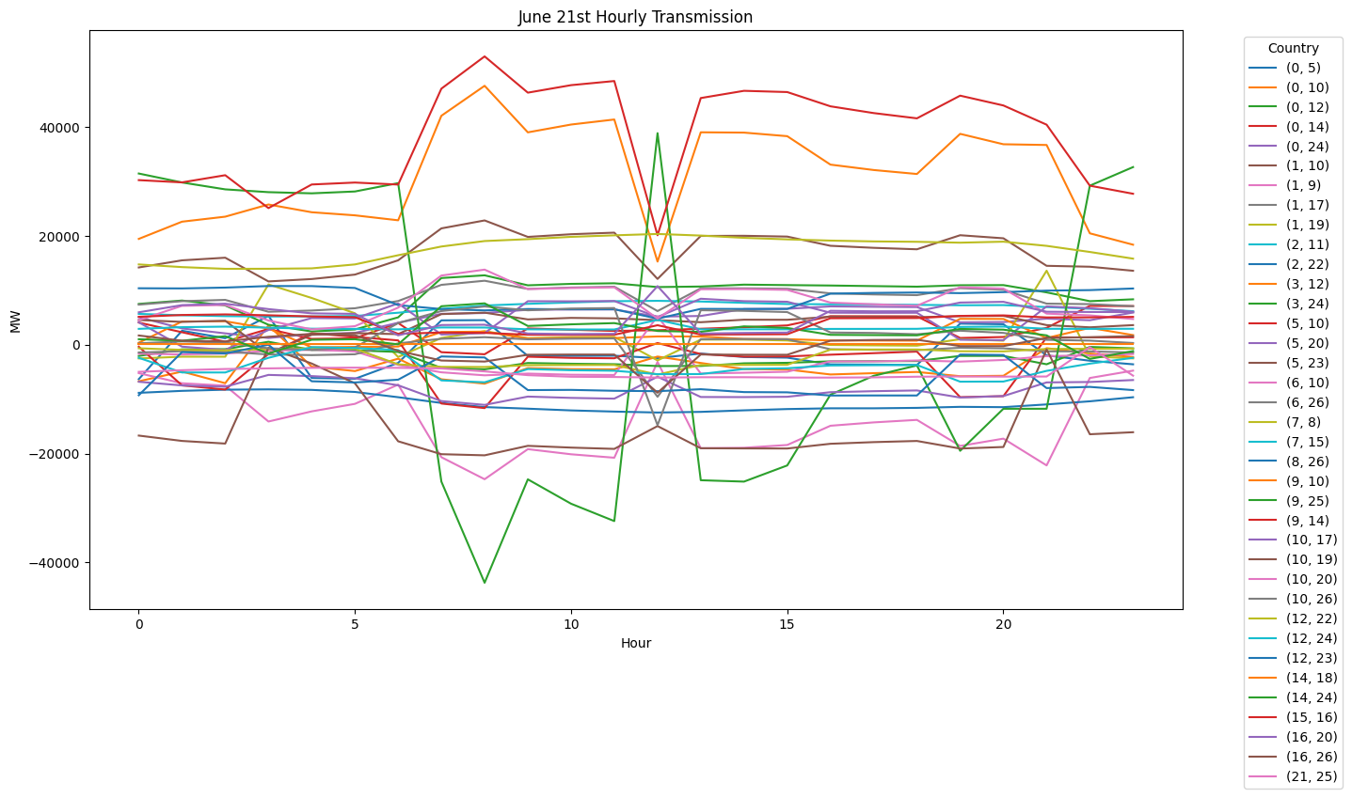
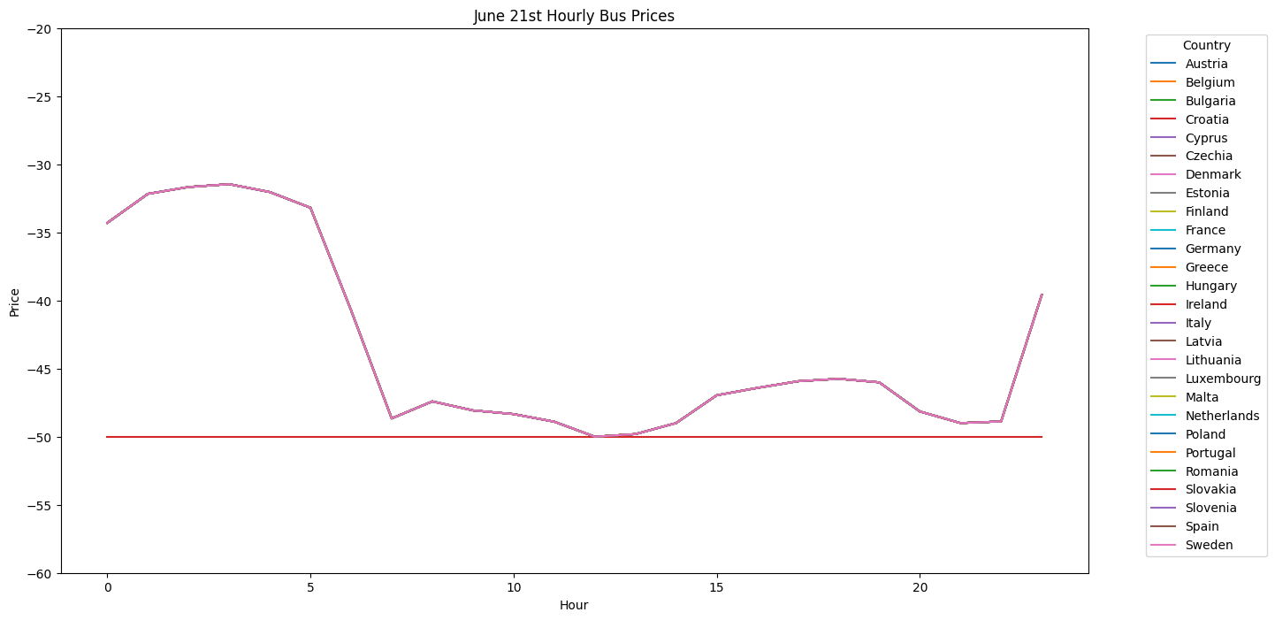
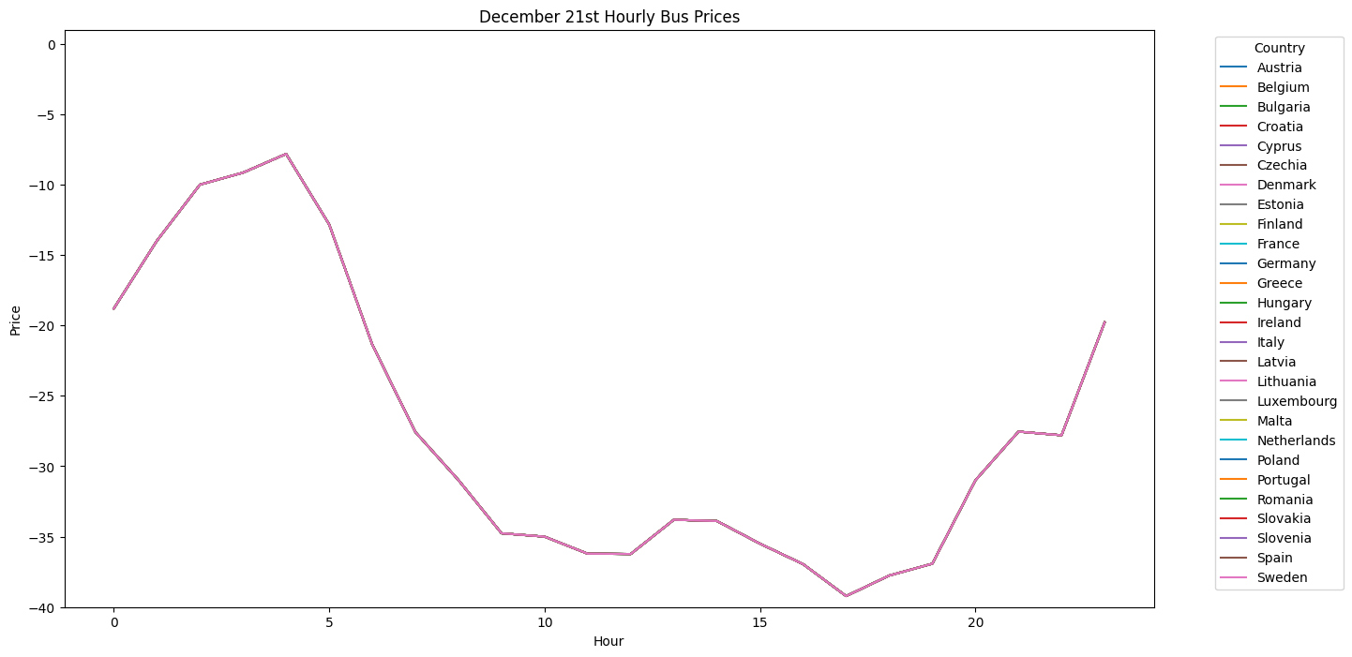
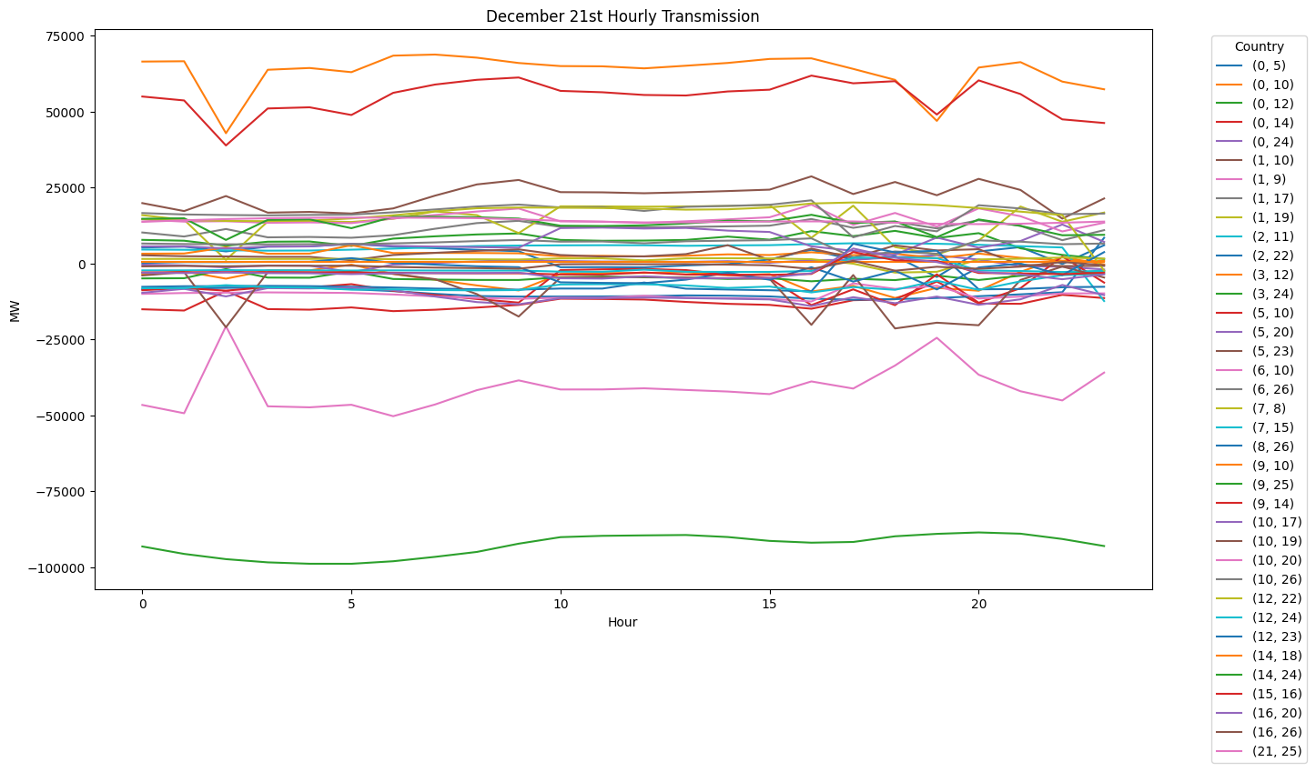

Slide 21
Bibliography
How Is EU Electricity Produced and Sold? - Consilium, www.consilium.europa.eu/en/infographics/how-is-eu-electricity-produced-and-sold/. Accessed 5 Dec. 2023. (1)
“Electricity Market Design.” Energy, energy.ec.europa.eu/topics/markets-and-consumers/market-legislation/electricity-market-design_en. Accessed 4 (2) Dec. 2023.
Jędrzejewski, Piotr. Modelling the European Cross-Border Electricity Transmission, kth.diva-portal.org/smash/get/diva2:1476768/FULLTEXT01.pdf. Accessed 5 Dec. 2023. (3)
Understanding Electricity Markets in the EU.” European Parliament Research Service, European Parliament, (4) www.europarl.europa.eu/RegData/etudes/BRIE/2016/593519/EPRS_BRI(2016)593519_EN.pdf. Accessed 5 Dec. 2023.
Data & Standardisation, European Union, www.entsoe.eu/data/. Accessed 5 Dec. 2023. (5)
“Live 24/7 Co₂ Emissions of Electricity Consumption.” Electricity Maps | Live 24/7 CO₂ Emissions of Electricity (6) Consumption, app.electricitymaps.com/map. Accessed 5 Dec. 2023.
“Energy Prices and Costs in Europe.” Energy, energy.ec.europa.eu/data-and-analysis/energy-prices-and-costs-europe_en. Accessed 5 Dec. 2023. (7)
“Energy Infrastructure in the EU.” Energy, energy.ec.europa.eu/energy-explained/energy-infrastructure-eu_en. Accessed 5 Dec. 2023. (8)
“Data Platform.” Open Power System Data, data.open-power-system-data.org/time_series/. Accessed 5 Dec. 2023. (9)

Slide 22
THANKS!

